Slide 1
Identifying minerals

Slide 2
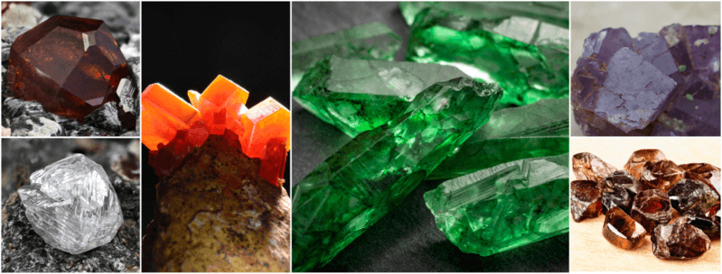
By the end of this Smart Lesson, you should be able to:
Recall the major characteristics studied in minerals.
Identify minerals based on their characteristics.

Slide 3
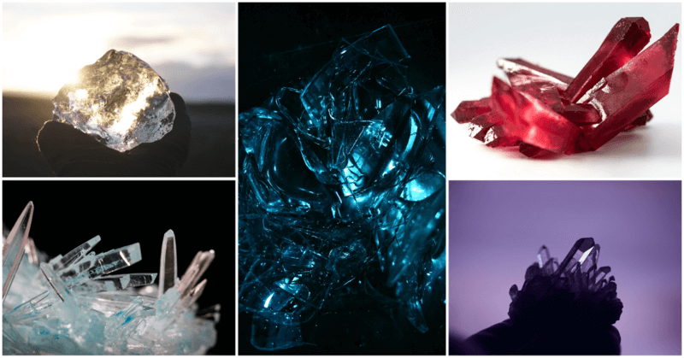
One of the easiest characteristics to look for in a mineral is its colour.
Many minerals have distinctive colours associated with them. The colour gold is named after the mineral, as are silver and copper. Let's also not forget that many gemstones in the world lend their names to even more dazzling colours: ruby, sapphire, emerald, amethyst—you get the idea.

Slide 4
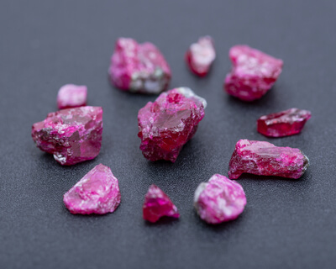
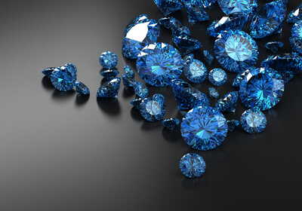
However, a given mineral can come in many different colours.
The best place to see this is in jewellery, as many gemstones are actually different forms of the same mineral.
Rubies and sapphires, typically red and blue respectively, are both forms of the mineral corundum.

Slide 5
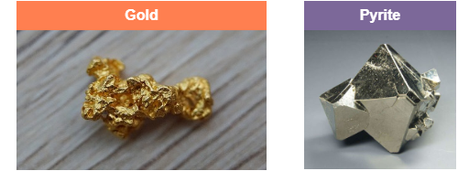
Here’s another case where colour is an unreliable measure.
Many minerals also have similar colours. For example, gold and pyrite are almost the same colour; in fact, many hopeful miners would mistake pyrite for gold, leading to its nickname of ‘fool’s gold’.

Slide 6
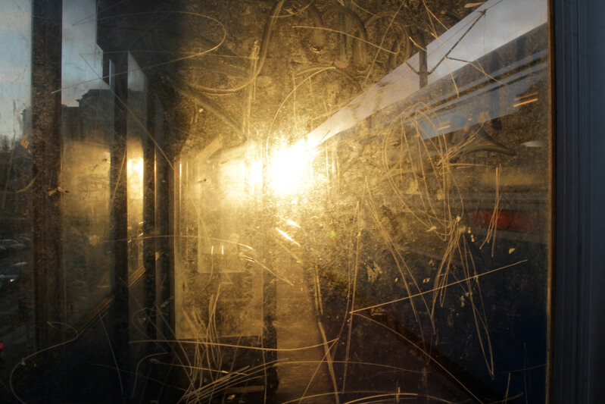
Minerals are a feast for the eyes, but not for the teeth.
The next characteristic we’ll look at is the hardness of a mineral. A hard mineral is difficult to bend, distort or leave a dent in. As a result, it easily leaves a scratch on a softer mineral.
For example, diamond is the hardest mineral, while talc is the softest. This means that diamond would leave a scratch on talc.

Slide 7
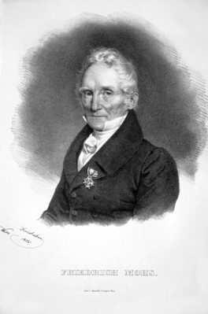
We measure hardness using the Mohs scales of hardness.
This scale was named after the German geologist Friedrich Mohs. He picked ten samples of minerals with distinctly different hardnesses, and gave them a number from 1 to 10. 1 is used for the softest mineral, while 10 is used for the hardest.
Many test kits use samples of minerals that have these assigned values. However, most test kits don’t include diamond, which has a value of 10, to cut down the cost.

Slide 8
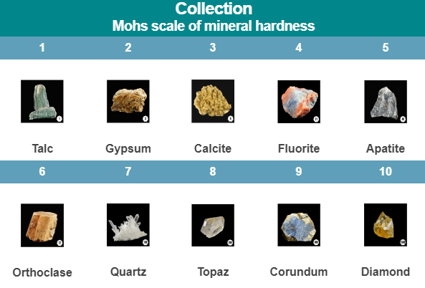

Slide 9
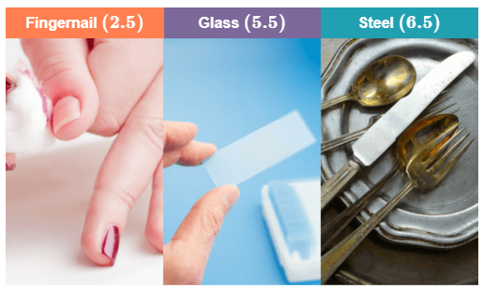
If you don’t happen to have a kit lying around, an even simpler test is the scratch plate test.
This requires a scratch plate made of glass, which has a Mohs value of 5.5. Because this value sits in the middle of the scale, glass is very useful as a benchmark for comparison.
In the scratch plate test, we take an unknown mineral sample and scrape it against a glass plate. If it leaves a scratch, we know that the mineral has a hardness of over 5.5. If not, we know that its hardness is less than 5.5.
We can be even more resourceful by using ourselves, or the things in our homes! Our fingernails have a hardness of 2.5, and steel (as in cutlery) has a hardness of 6.5.

Slide 10
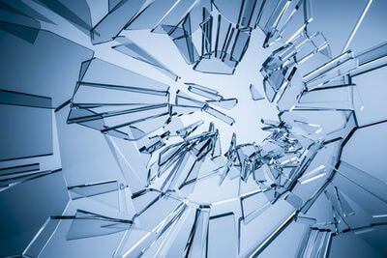
Now that we’ve seen how strong minerals are, let’s see how they break.
Some minerals fracture in particular patterns, while others fracture into random shapes. This property is called the cleavage of a mineral.

Slide 11
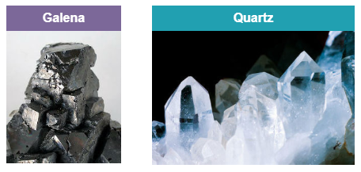
Let’s look at galena and quartz as an example.
Galena looks like it’s been sculpted, but it hasn’t! Galena naturally fractures into neat cubes with flat, shiny faces.
Now compare it to quartz. This glassy mineral breaks into incredibly sharp fragments.

Slide 12
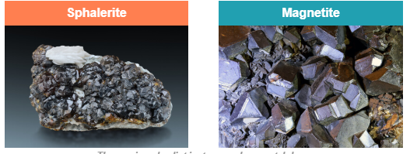
Another characteristic we study is lustre.
Lustre describes the reflective property of a mineral. In other words, how shiny is it?
There are a great many words we use to describe the lustre of a mineral, so here’s the easiest one: metallic. Minerals with metallic lustres are very reflective. Sphalerite and magnetite are two such examples.

Slide 13
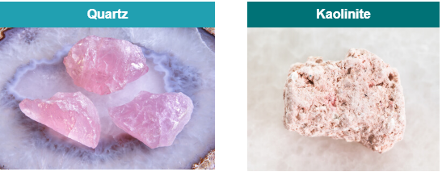
Many lustrous minerals appear glassy, while others look dull.
We use the term vitreous to describe these glassy minerals. Quartz and fluorite are two such examples. Of course, there are some minerals that don’t seem to reflect light at all, such as bauxite and kaolinite. We describe the lustres of these minerals as earthy (or dull). Don’t discount these minerals just because they’re dull, though: they’re important parts of the Earth’s crust!

Slide 14
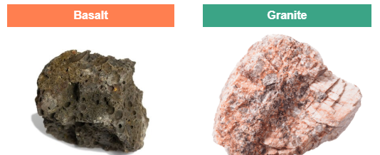
The final characteristic we’ll consider is the density of a mineral.
Density is a property that describes how heavy an object is for a given volume.
If two objects have the same volume, the one with the greater density is always heavier. Density is measured numerically in grams per cubic centimetre (g cm⁻³). The rock basalt, a component of the Earth's oceanic crust, is denser than granite, a component of the Earth's continental crust.

Slide 15
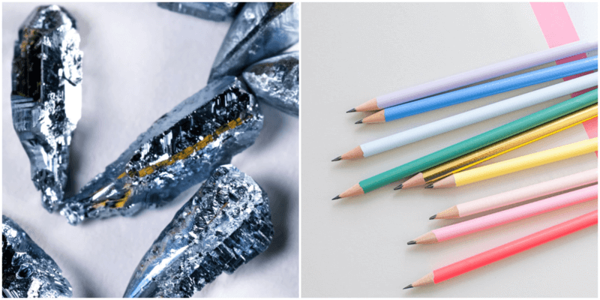
Osmium is said to be the densest mineral on Earth. Let’s see the numbers to back this up!
It turns out that osmium’s density is 22.6 g cm⁻³. In contrast, graphite’s density is a measly 2.3 g cm⁻³! To put it like this: A pencil typically weighs 6–7 g. If the pencil lead were made of osmium, that pencil would weigh about ten times as much! Not something you’d write with everyday.

Slide 16
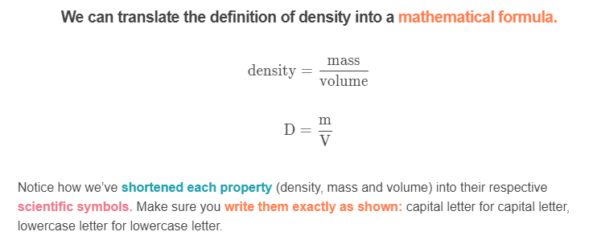

Slide 17
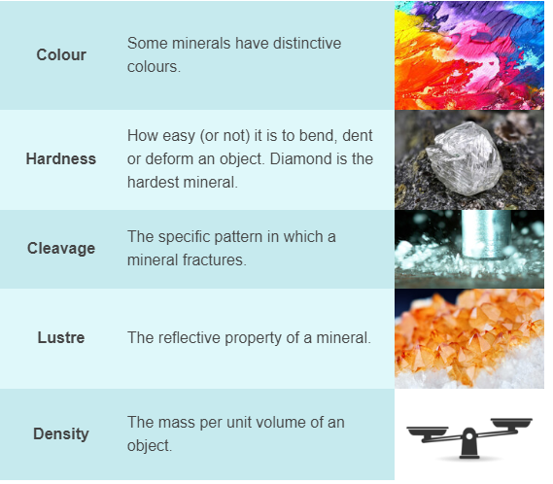
Let’s cap off with a summary of the mineral characteristics we’ve just learnt!

